Slide 1
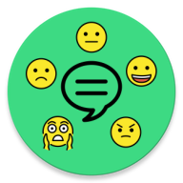

FeelChat: Automatic Recognition of The User’s Emotional State in One-to-One Chat
Francesco Iemma
Lorenzo Massagli
Niko Salamini
Olgerti Xhanej

Slide 2
TABLE OF CONTENTS
01
INTRODUCTION
02
APPLICATION
POWER CONSUMPTION ANALYSIS
03
04
MODEL ANALYSIS

Slide 3
01
INTRODUCTION

Slide 4
— Dr. John Campo (Director of the Division of Child and Adolescent Psychiatry at Johns Hopkins University School of Medicine)
“When mental health is ultimately recognized as essential to physical health, not an extraneous element of it, then we will have access to true, complete, modern medicine.”

Slide 5
— World Health Organization (https://www.who.int/news-room/fact-sheets/detail/depression)
SOME NUMBERS….
“Depression is a common illness worldwide. […] Approximately 280 million people in the world have depression ”
”At its worst, depression can lead to suicide. Over 700 000 people die due to suicide every year. Suicide is the fourth leading cause of death in 15-29-year-olds.”
“Although there are known, effective treatments for mental disorders, more than 75% of people in low- and middle-income countries receive no treatment. Barriers to effective care include a lack of resources, lack of trained health-care providers and social stigma associated with mental disorders. In countries of all income levels, people who experience depression are often not correctly diagnosed.

Slide 6
APPLICATION FIELDS
Communication
Healthcare
Marketing

Slide 7
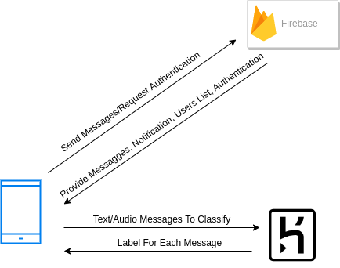
ARCHITECTURE
The System architecture is made up of:
Android Application
Firebase Realtime Database
Firebase Storage
REST Server on Heroku

Slide 8
02
APPLICATION

Slide 9
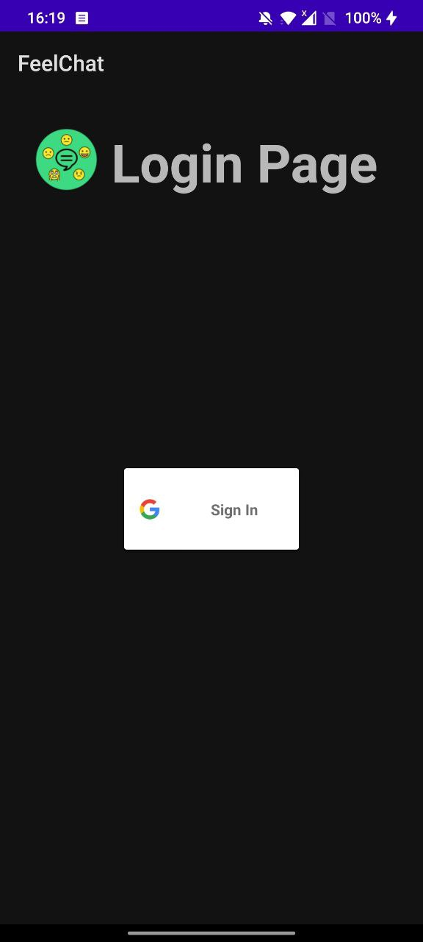
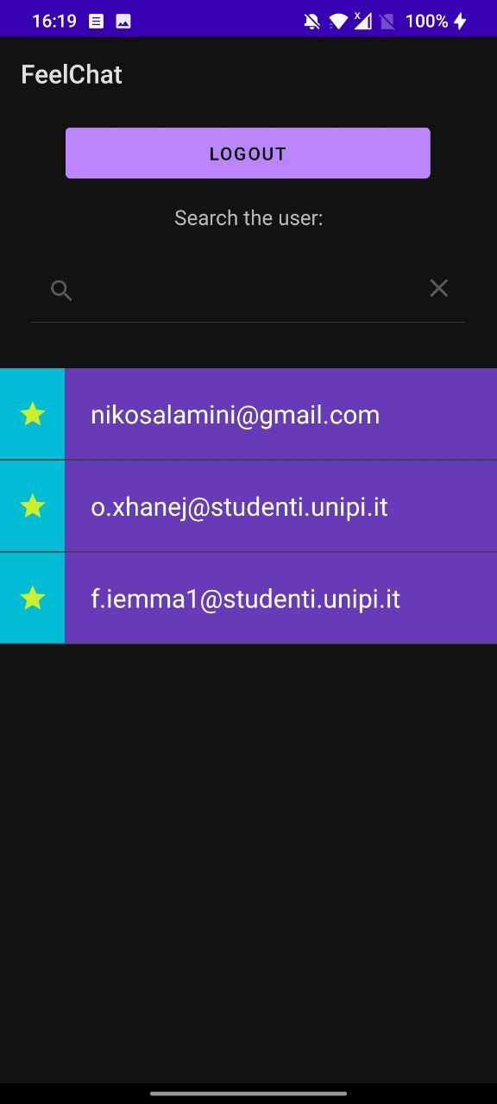
LOGIN & CONTACTS ACTIVITY
Login with Google OAuth
Favorites
Search by email

Slide 10
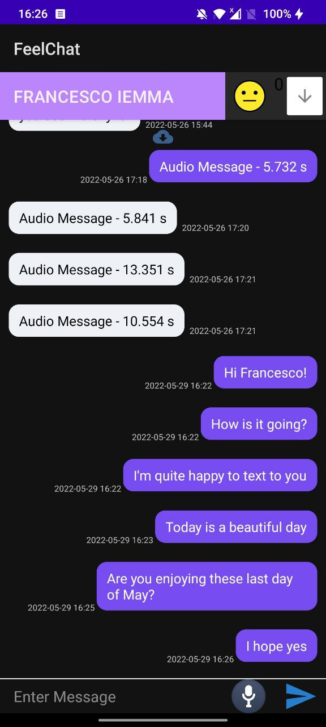
CHAT ACTIVITY
Text messages and Audio messages (WAV)
Message fetching windowed
Caching of Audio Messages
Notifications
Aggregated Emotion Classification

Slide 11
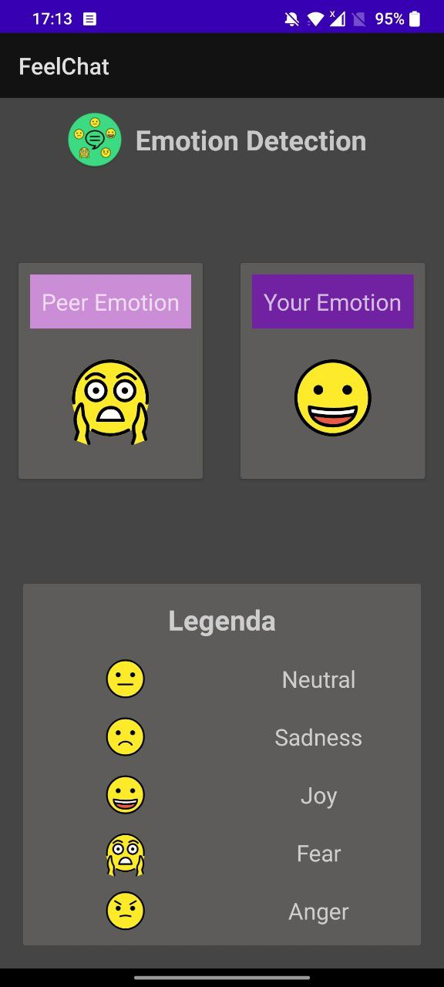
EMOTION ACTIVITY
A
A
T
T
T
T
T
A
T
A
T
T
5 Possible emotions
Classification by Sender
Current Emotion: Window of last block of 5 Messages
Aggregation policy: majority
classification
[joy, fear, neutral, joy, anger]
majority
joy

Slide 12
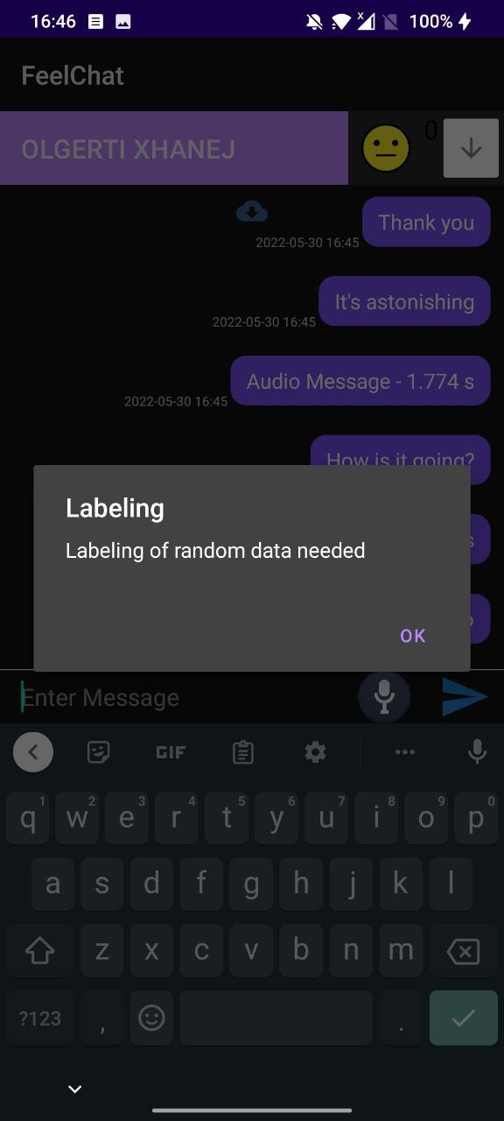
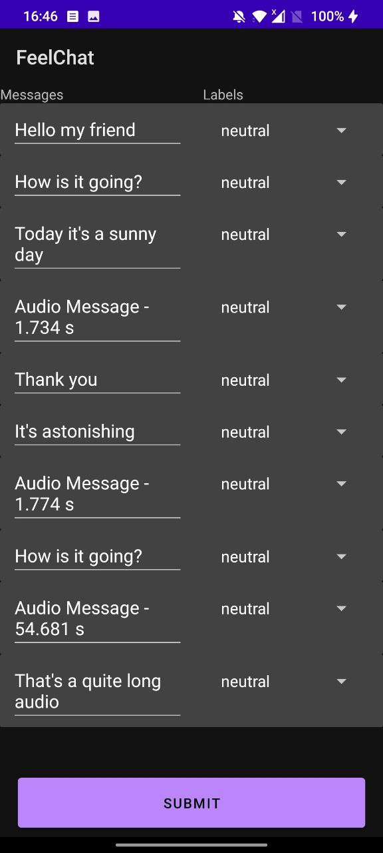
LABELING ACTIVITY
Participants need to carry out manual labeling
Neutral in case of uncertainty

Slide 13
03
MODEL ANALYSIS

Slide 14
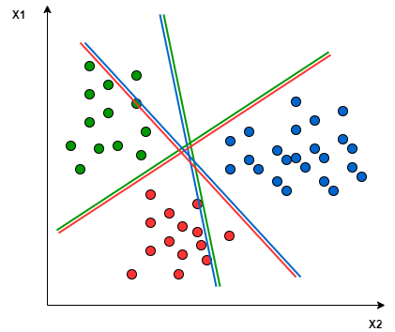
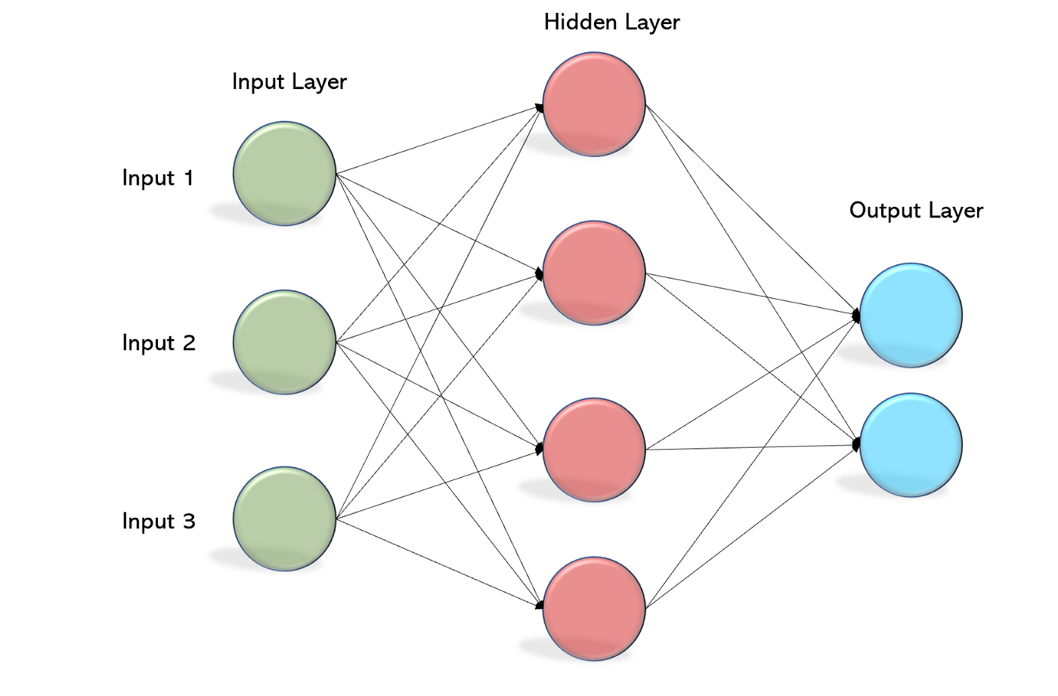
MODELS
Text Emotion Detection Model
Support Vector Machine (SVM)
WASSA Dataset
Text cleaning + TF-IDF
Audio Emotion Detection Model
Multilayer Perceptron (MLP)
RAVDESS + TESS + EMO-DB Datasets
Feature Extraction: MFCC

Slide 15
TEXT EMOTION RECOGNITION TESTS
We have performed 4 different tests using different dataset combinations:
1) WASSA + USER dataset for train and test
2) WASSA dataset for train and test
3) USER dataset for train and test
4) WASSA dataset for train and USER dataset for test

Slide 16
TEXT EMOTION DETECTION RESULTS
 | WASSA + USER (train and test) | WASSA (train and test) | USER (train and test) | WASSA (train) + User (test)
Accuracy | 0.51 | 0.84 | 0.64 | 0.38
Precision | 0.52 | 0.84 | 0.59 | 0.50
Recall | 0.46 | 0.83 | 0.60 | 0.38
F1_score | 0.47 | 0.84 | 0.59 | 0.38
Total train user labels (after undersampling): 220 instances -> 44 for each class
Total test user labels: 72 instances
Bias example:
WASSA dataset -> “DAMN!“ = Neutral
USER dataset -> “DAMN!“ = Sadness

Slide 17
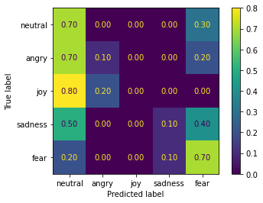
AUDIO EMOTION DETECTION MODEL
Dataset = TESS + RAVDESS + EMO-DB
 | Dataset (train and test) | Dataset (train) and User (test)
Accuracy | 0.78 | 0.38

Slide 18
04
POWER CONSUMPTION ANALYSIS

Slide 19
About the Experiments
The experiments consists in automating a common usage of the application with an adb command script:
The chat was reloaded every 15 seconds in a window of 20 minutes
Device screen brightness fixed for the entire experiment
Caching of audio images disabled
Devices connected via WiFi
Battery historian tool to analyze the results of each experiment

Slide 20
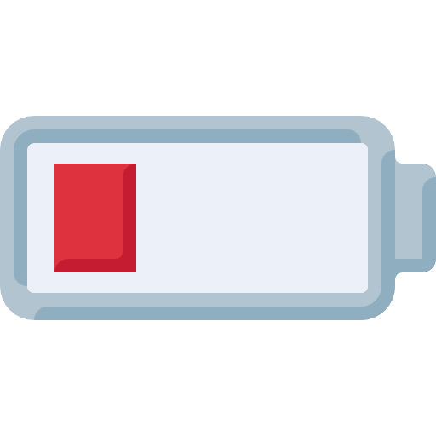
Results
Cells: Device Estimated Power Usage, WiFI Data Transfer
#Text/#Audios In Chat | OnePlus 7T | OnePlus Nord | Mi 10 Lite 5G
10/0 | 0.03%, 0.78Mb | 0.04%, 0.38Mb | 0.05%, 0.68Mb
9/1 | 0.13%, 69.6Mb | 0.06%, 25.52Mb | 0.37%, 67.75Mb
7/3 | 0.34%, 211Mb | 0.22%, 106.11Mb | 1.10%, 225.8Mb
The power consumption increases when #Audios increase!

Slide 21
Further improvements
About Emotion Detection:
We can improve the text classificator gathering more data
We can find a better policy to merge the data coming from the audio and the text classification model
About the power consumption:
We can find a compromise between the audio quality and the user experience to reduce the amount of traffic coming from the devices.

Slide 22
THANK YOU FOR YOUR ATTENTION! Any Questions?

